Slide 1
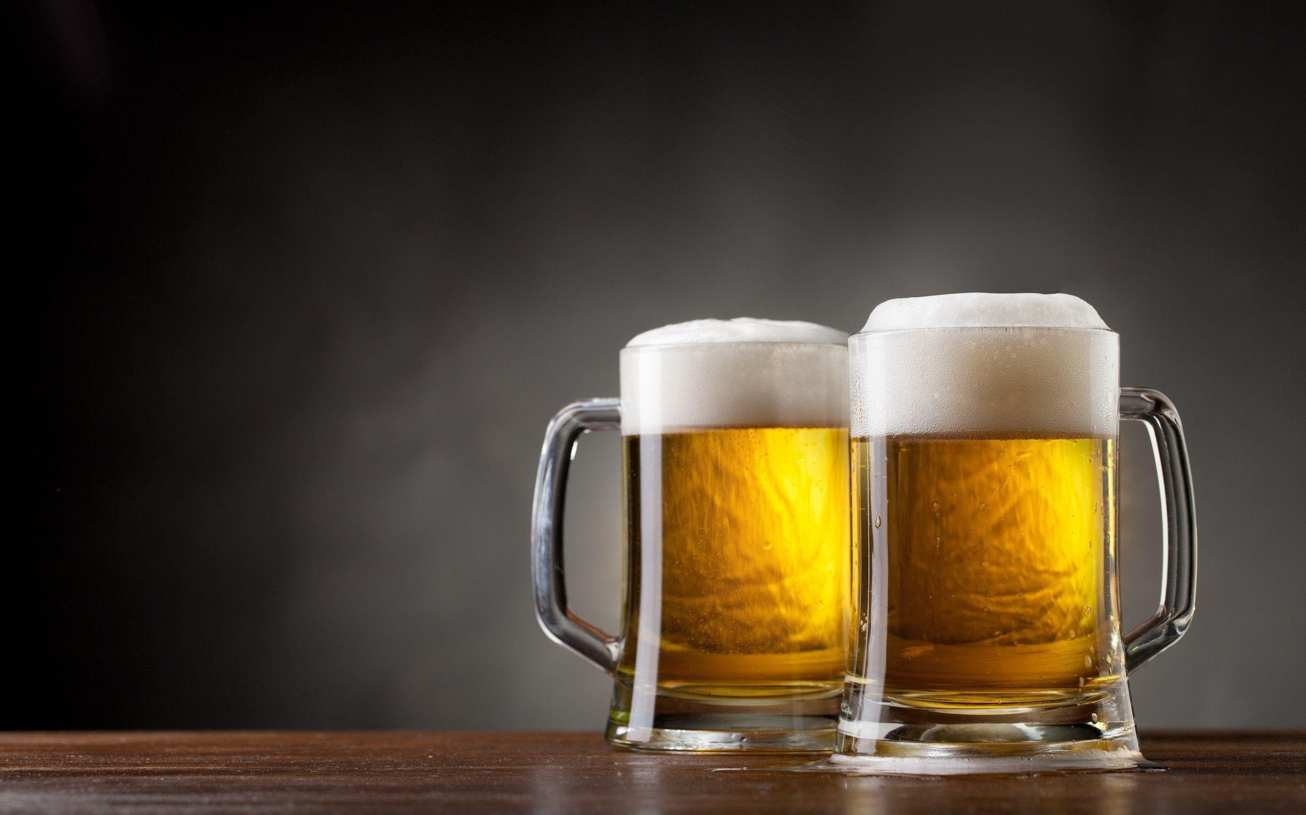
.
.
.
.
.
Beer Categorization
Group A:
Jay Kansara
Mugunthan Rengarajah
Zhifen (Alex) Zhang
Shamay Bahar

Slide 2
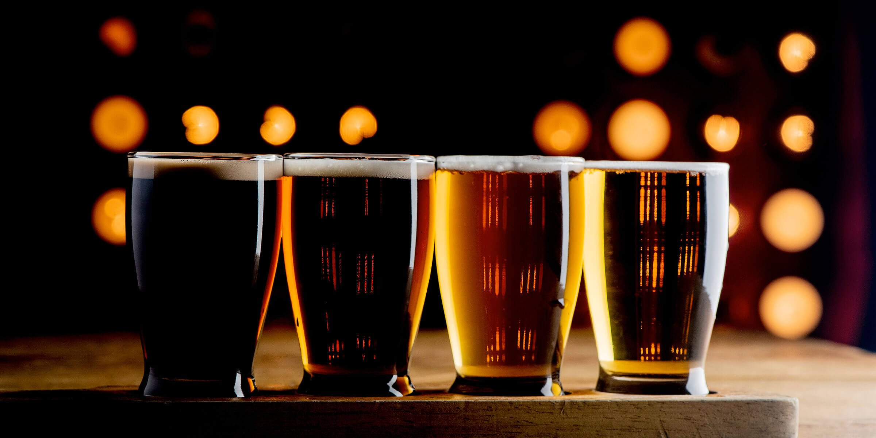
Research Question
Is it possible to successfully predict a beer’s category based on:
Look
Smell
Taste
Feel
Overall
State of Brewery
Availability
Distribution
Alcohol by Volume

Slide 3
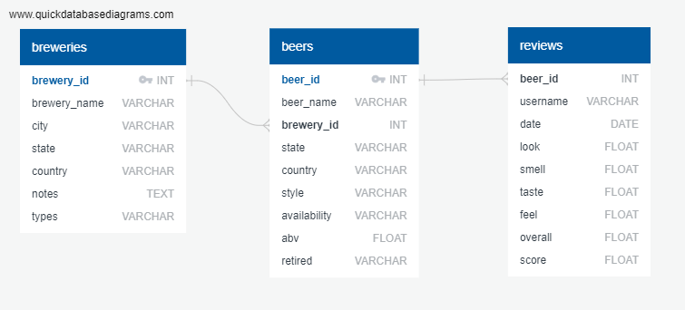

Data Source Description
Data Sources
Entity Relationship Diagram
breweries.csv
beers.csv
reviews.csv

Slide 4


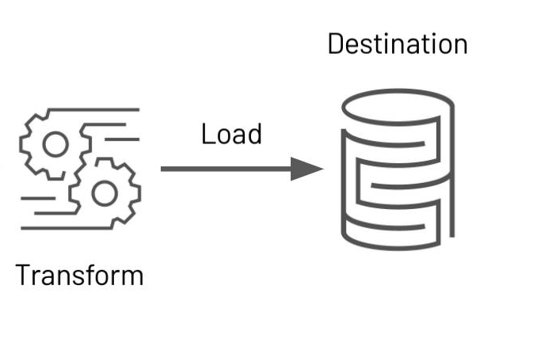
Transformation and Load
Data was transformed by:
Data was uploaded to a PostgreSQL database
Categorized similar beer styles
Grouped beers with less than 10,000 reviews into a other category
Dropped null values
Encoded features such as Beer Category, State, and Availability

Slide 5

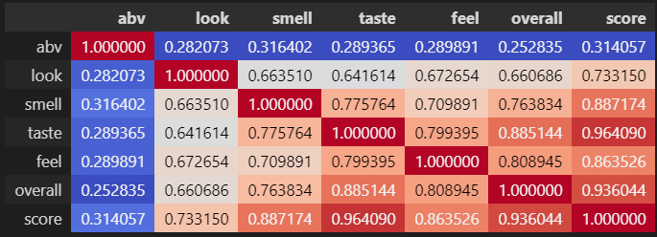
Data Exploration
Many variables are highly correlated to each other (> 0.75%)
To handle the highly correlated variables we:
Multiplied highly correlated variables together
Dropped one of the highly correlated variables from the model

Slide 6
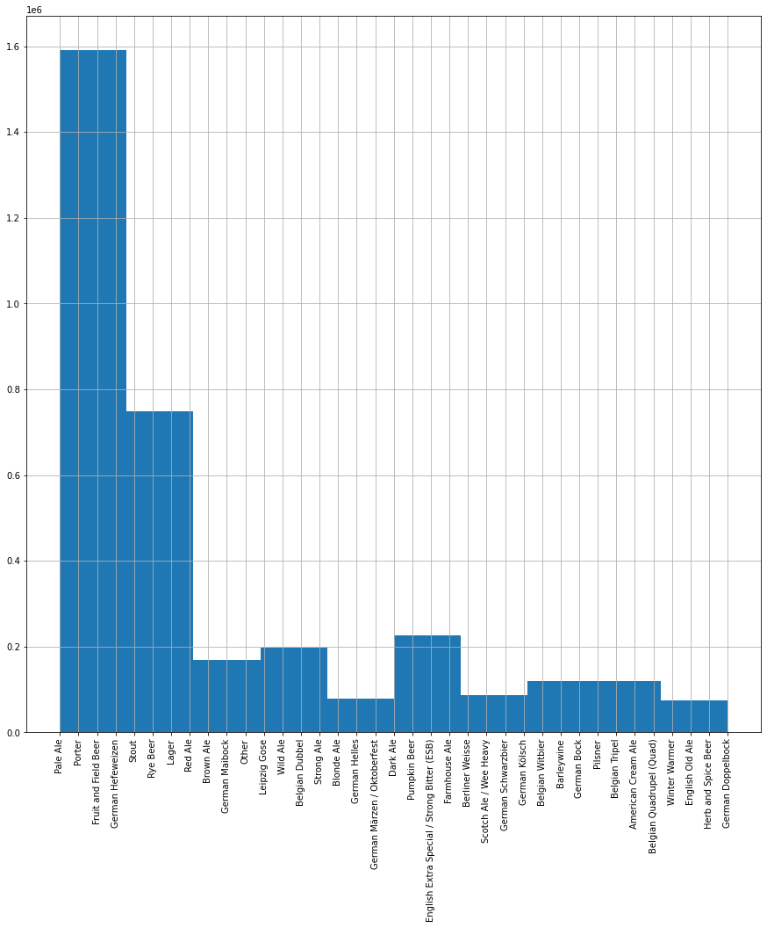
Data Exploration
Pale Ales have significantly more reviews than other beer categories
Quads, winter warmers, Herb and Spice Beers, and Doppelbocks have the least amount of reviews

Slide 7
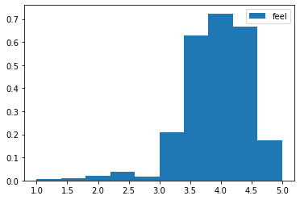
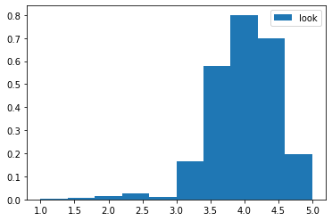
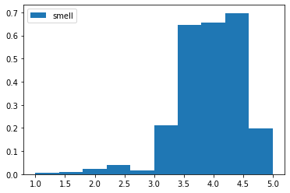
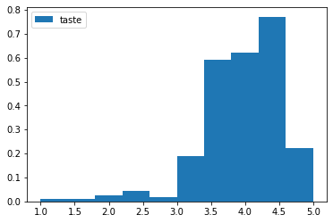
Data Exploration
All review features are left skewed
Across all review columns, most reviews received 3 or more

Slide 8
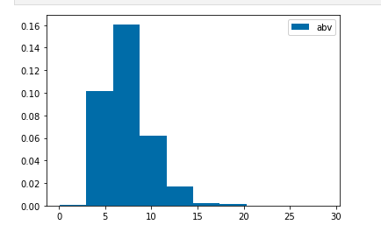
Data Exploration
All review features are left skewed, except ABV
ABV exhibiting more symmetry compare to other features

Slide 9
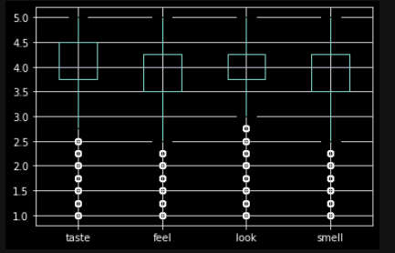
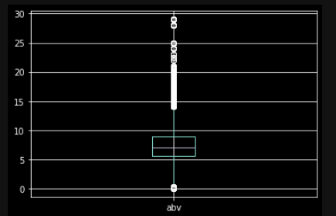
Data Exploration
Only ~5% of the outliers of all features, insignificant for ML model
Scaling was performed to ensure accuracy in XGBoost & Random Forest

Slide 10




Technology, Languages, and Tools
ETL and Exploratory Analysis
Machine Learning
Database

Slide 11

Machine Learning

Slide 12
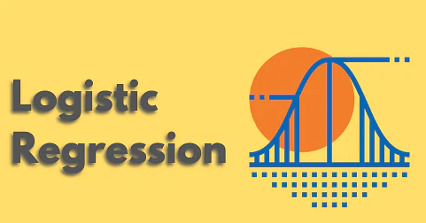
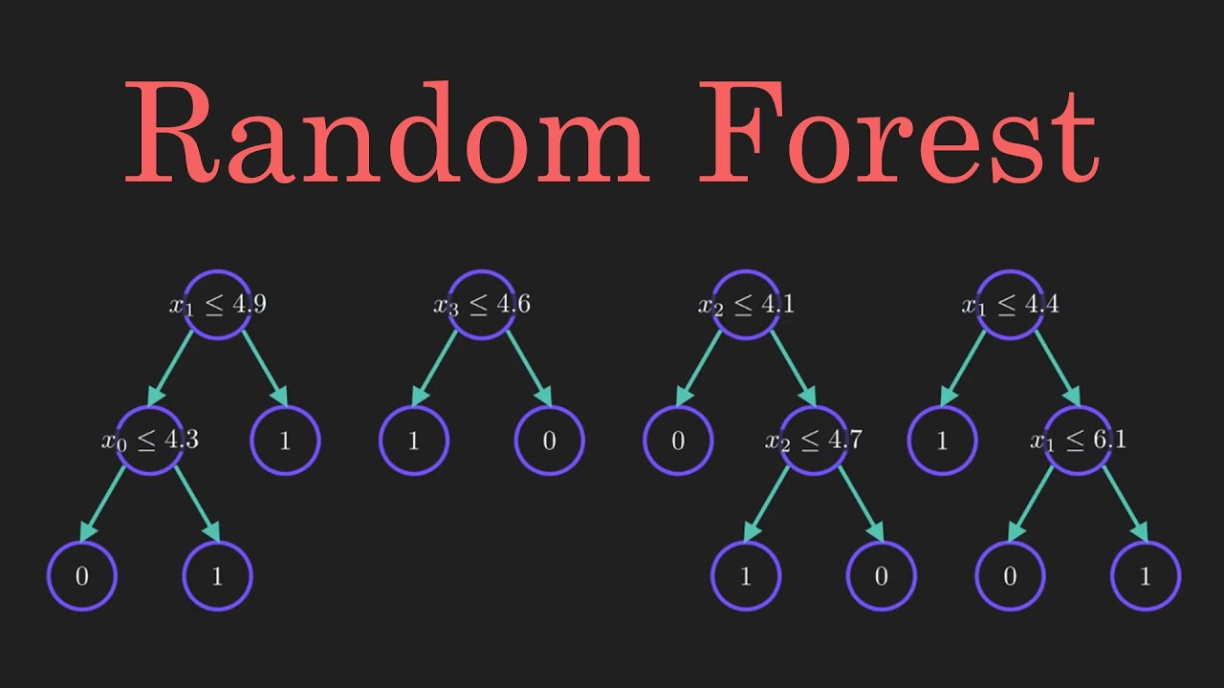
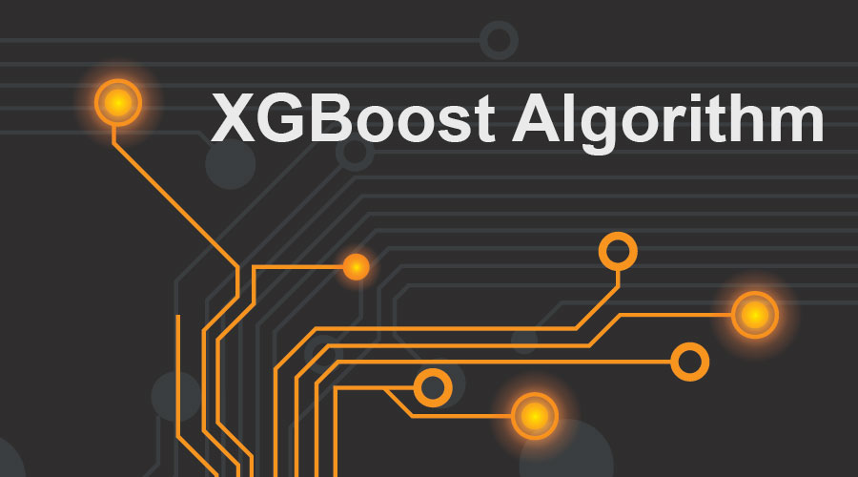
Model Selection
Accuracy: 11%
Accuracy: 60%
Accuracy: 71%

Slide 13
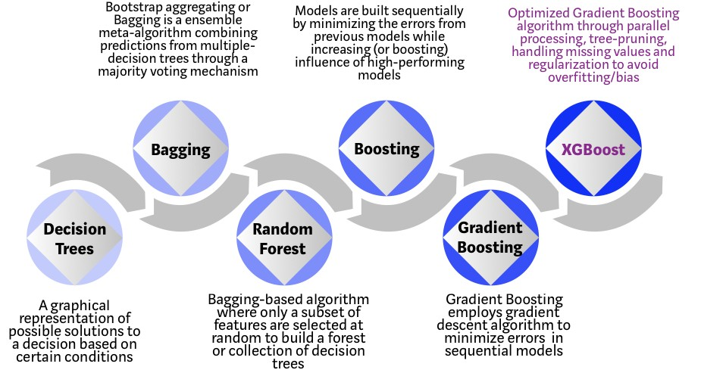
Evolution of XGBoost

Slide 14
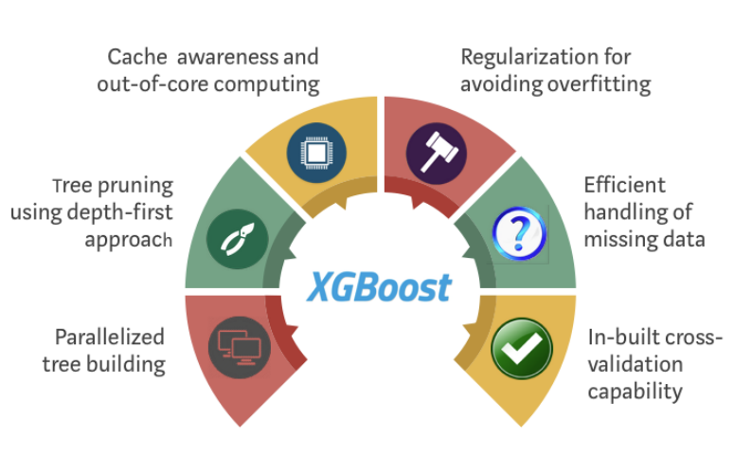
XGBoost Model
Benefits:
Highly Flexible
Uses the power of parallel processing
Faster than Gradient Boosting
Supports regularization
Designed to handle missing data with its in-build features.
Works well in small to medium datasets
Limitations:
XGBoost does not perform quite well on sparse and unstructured data
Can be memory hungry and slow
Preliminary accuracy score on our dataset: 71%

Slide 15
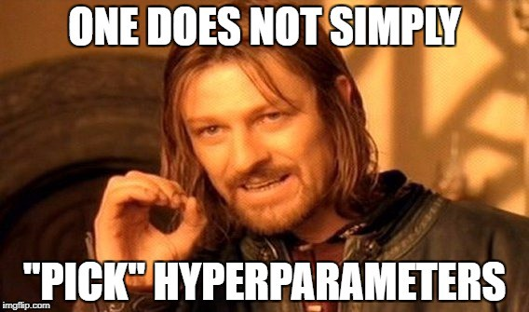
Hyperparameter Tuning

Slide 16
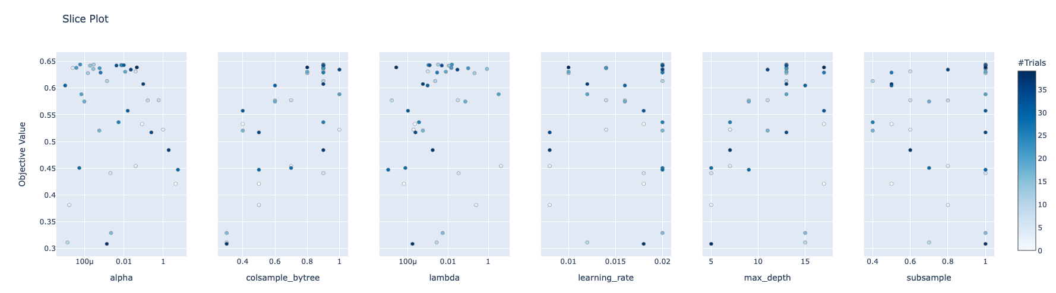
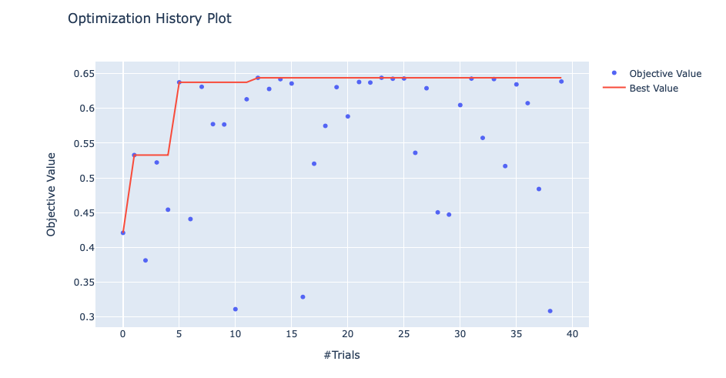
Hyperparameter Tuning
N_estimator tuning using GridSearchCV
Hyperparameter tuning with Optuna (lambda, alpha, learning rate, subsampling etc.)
Smaller testing sample to find best parameters

Slide 17
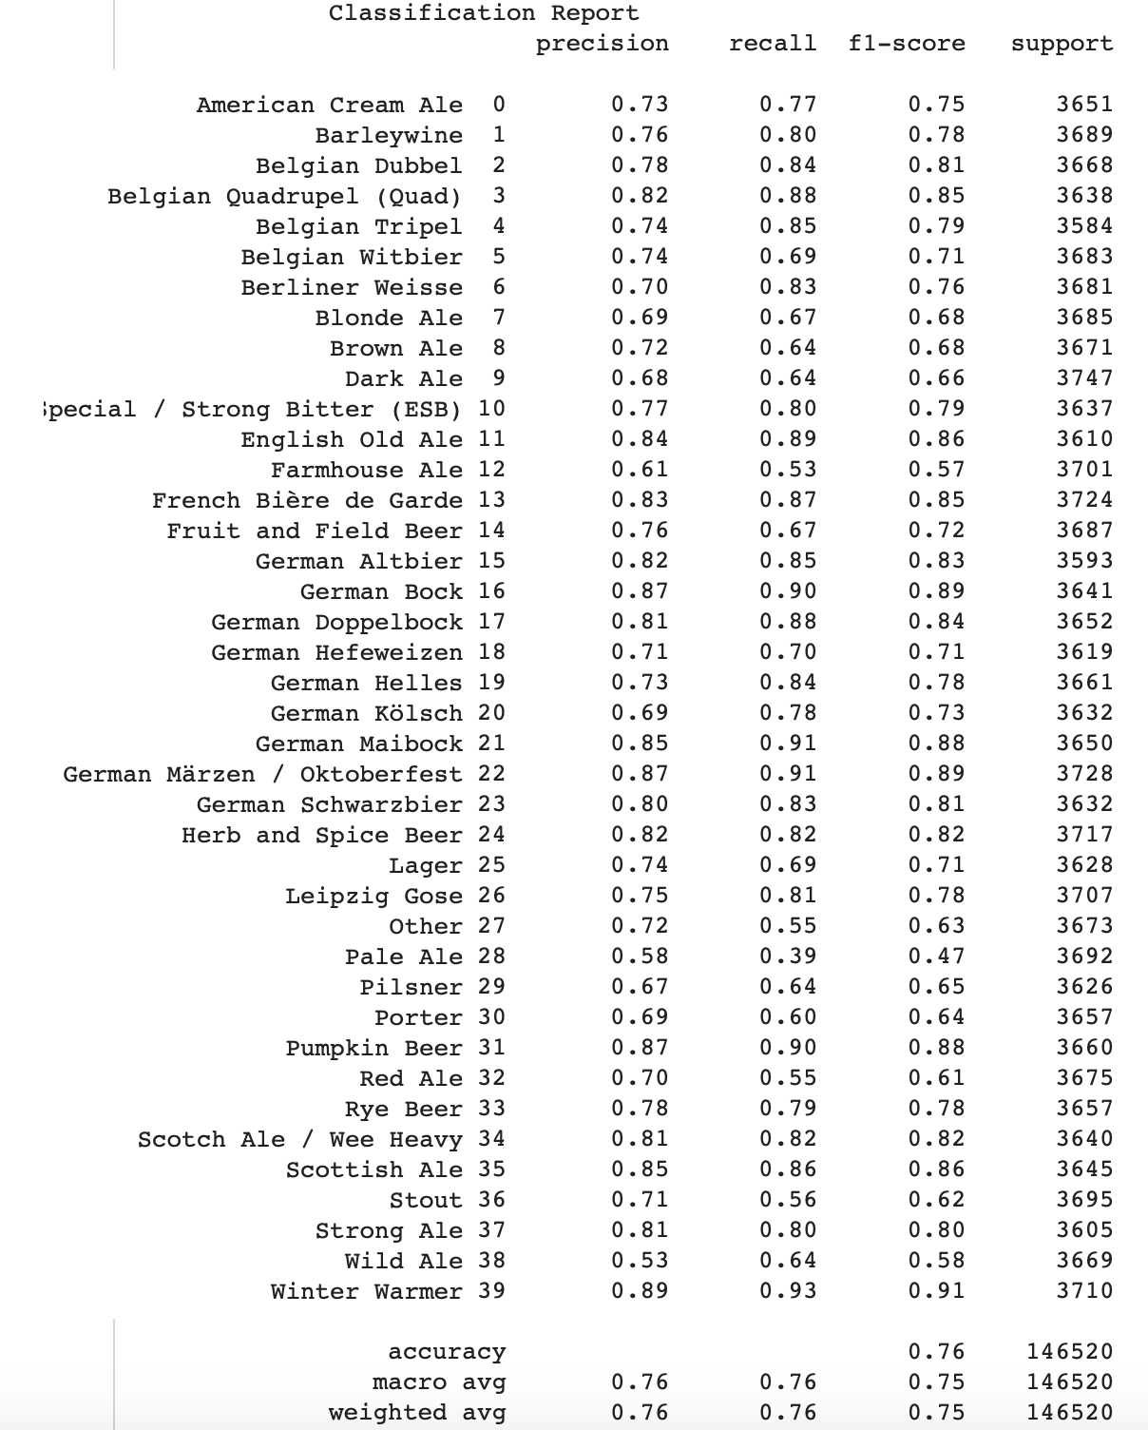
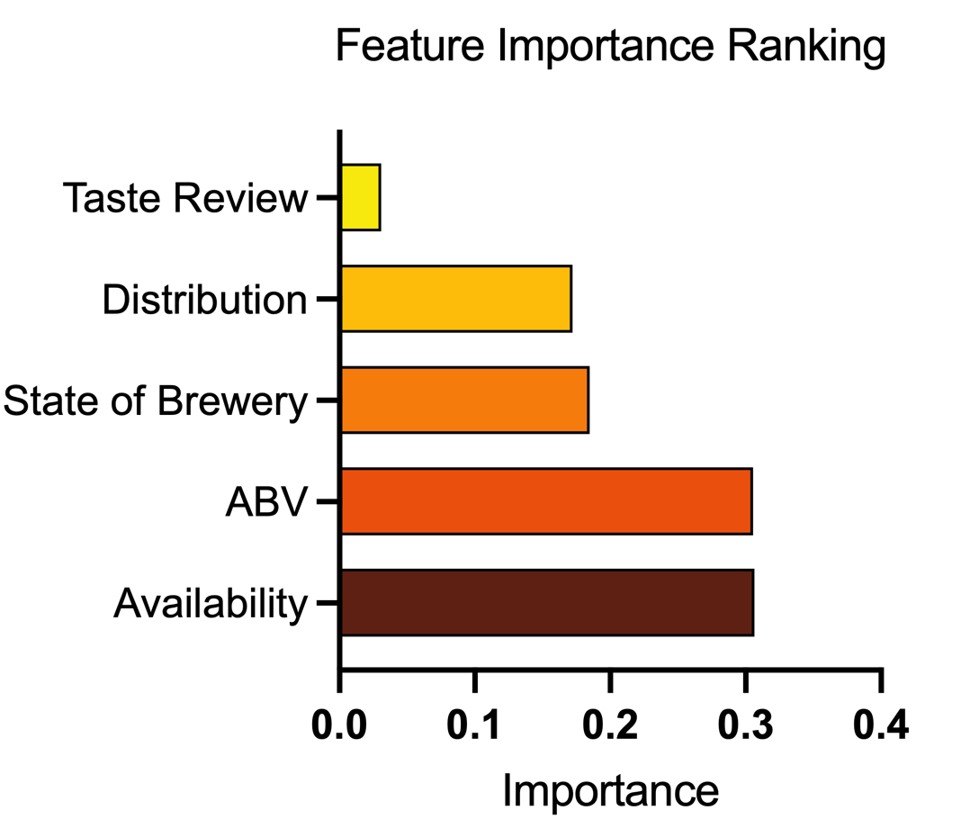
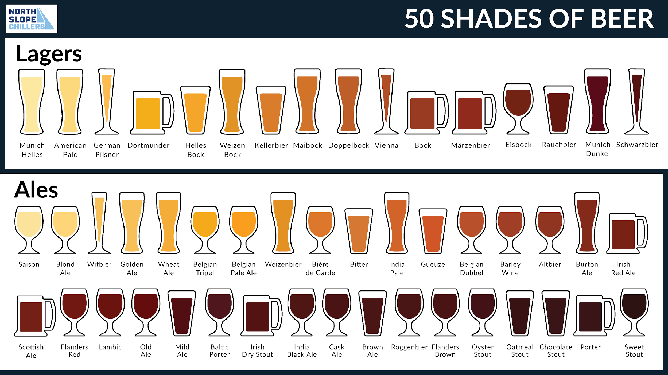
Results
 | Accuracy | Precision | Recall | F1-Score
Testing | 76% | 76% | 76% | 75%
Training | 80% | 80% | 80% | 79%
Notes:
Recall vs precision? Recall? limitations

Slide 18
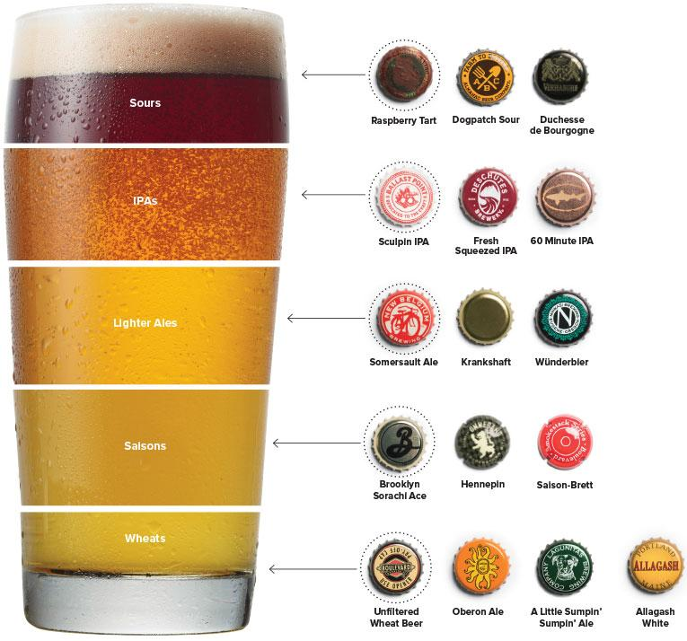
Summary of Beer Prediction Model
76%
Hyperparameter
Tuning
XGBoost
71%
Optimized
XGBoost
64%
XGBoost
60%
Random Forest
11%
Logistic Regression
We can successfully predict the type of beer based on brewery, beer features and beer reviews (>75%).

Slide 19
Limitations and Recommendations
Beer categories are not perfect
Should a dark pale ale be categorized as a dark ale or pale ale?
Not all beer types are predicted equally well
Oversampling/undersampling
Recommend trying different stratifying method
Limited computing power for optimization and model tuning
Recommend cloud platforms
Recommend knowledge distillation
Notes:
cross validation (subsets)

Slide 20


Dashboard!!!

